Slide 1
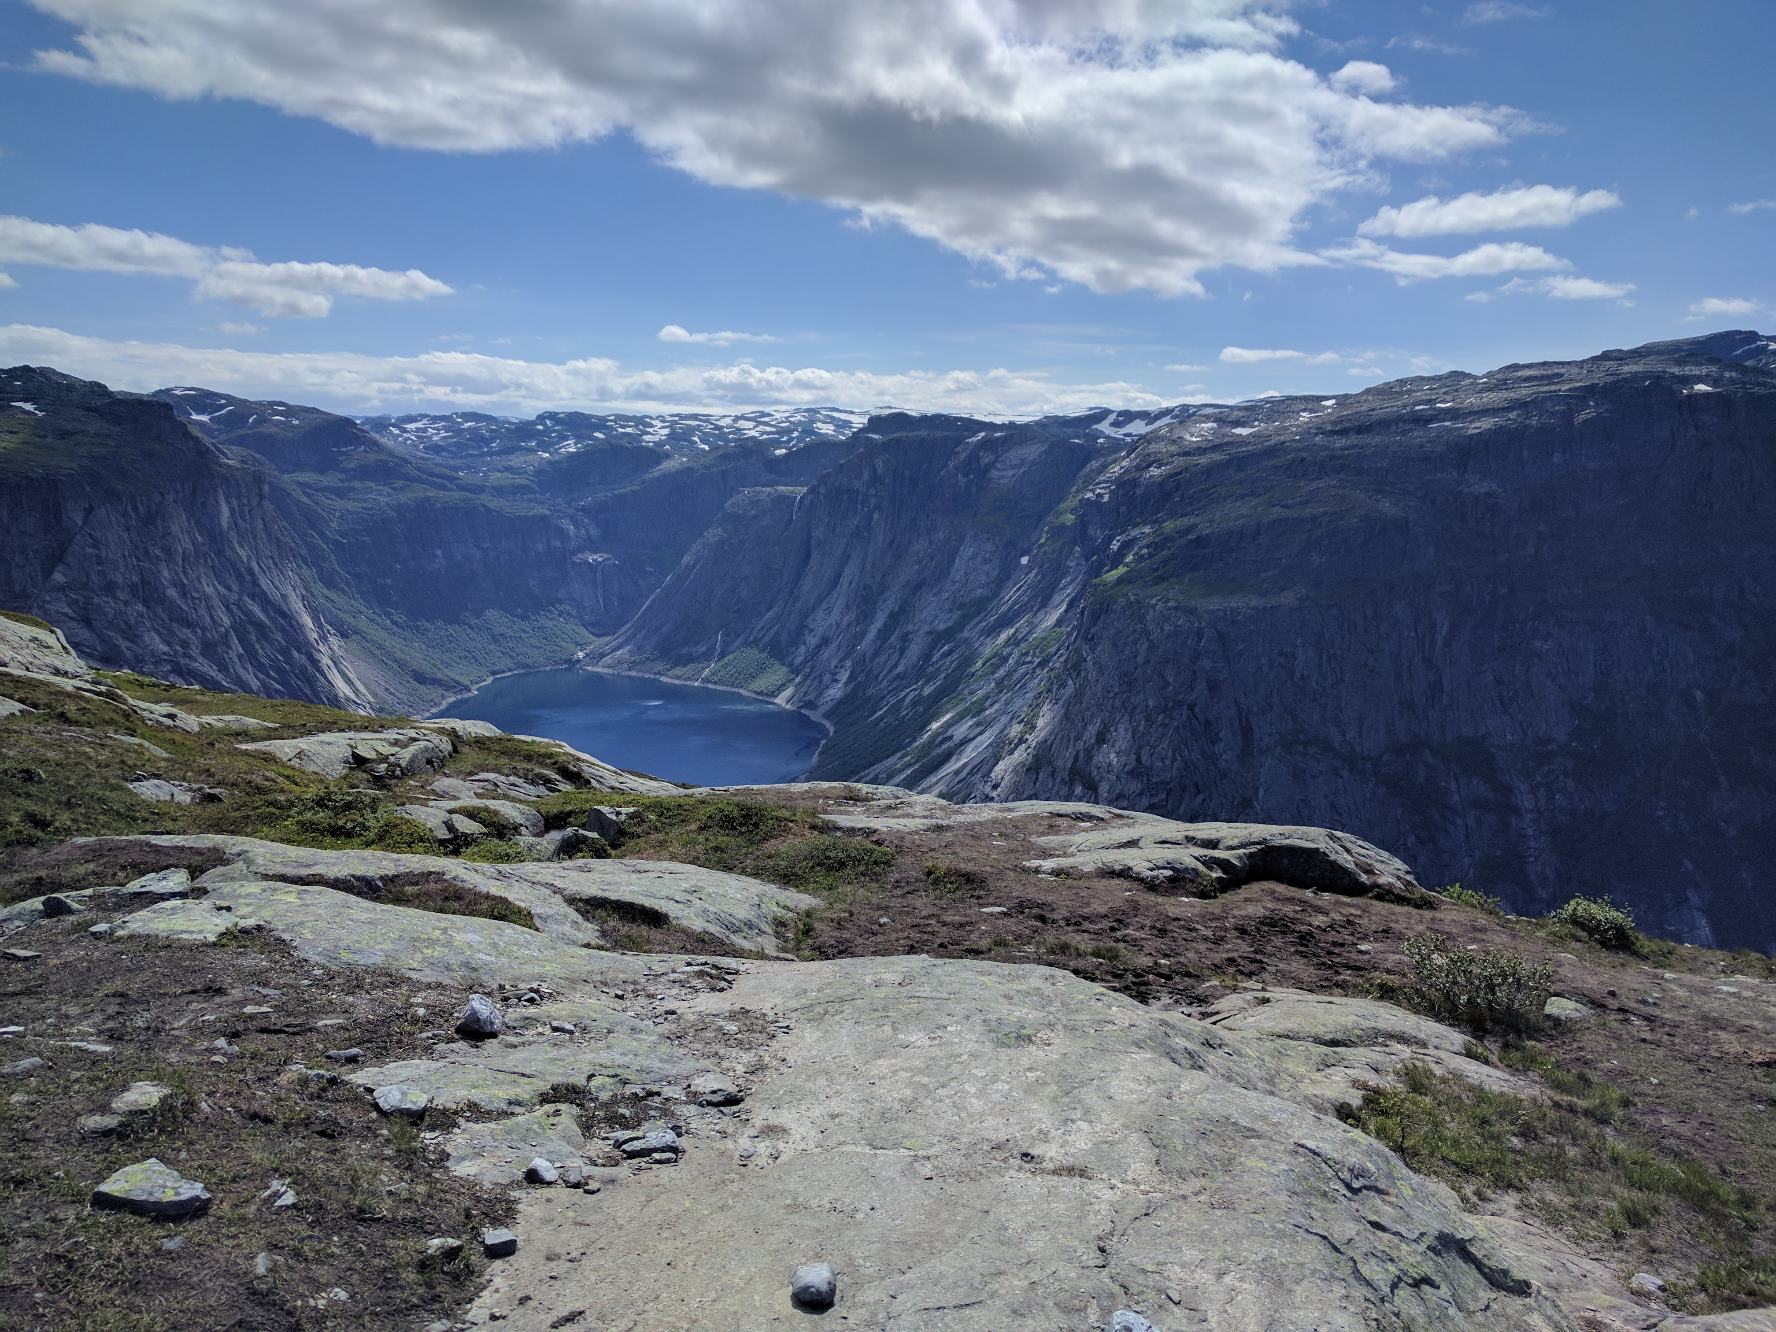
Data Lake Ingestion checklist
By Dmytro Dragan

Slide 2

BIG DATA LEAD ENGINEER
SUMMARY OF QUALIFICATIONS
Dmytro Dragan has 9 years of experience in Software Design and Development, where he converts client`s ‘want to’ in production-ready solutions.
Last 5 years his focus lies on building data pipelines on open-source frameworks and tools.
He’s also worked on quite disparate things such as real-time anti-fraud system, phone gpu image processing, machine learning modeling.
TECHNOLOGIES
RDBMS: Oracle, MS SQL Server, DB2
NoSQL: Redis, Cassandra
Hadoop stack: Hive, Impala, HBase, Spark
AWS stack: AWS Glue, Lambda, Athena, EMR, DynamoDB, Redshift
GCP stack: Dataflow, Cloud Function, Dataproc, Composer, BigTable, BigQuery
Streaming Frameworks: Flink, Kafka-Streams, Flume, Storm
ML: Jupyter, TensorFlow, H2O, R ​
DMYTRO DRAGAN

Slide 3
WHAT IS OUR GOAL?

Slide 4
WHAT IS OUR GOAL?
To understand what clients want
To give clients what they want

Slide 5
I like this example

Slide 6
WHAT IS OUR GOAL?
To understand what clients want
To give clients what they want
To understand what clients need
Show them both
Help client to choose

Slide 7
Ingestion is simple… right?

Slide 8
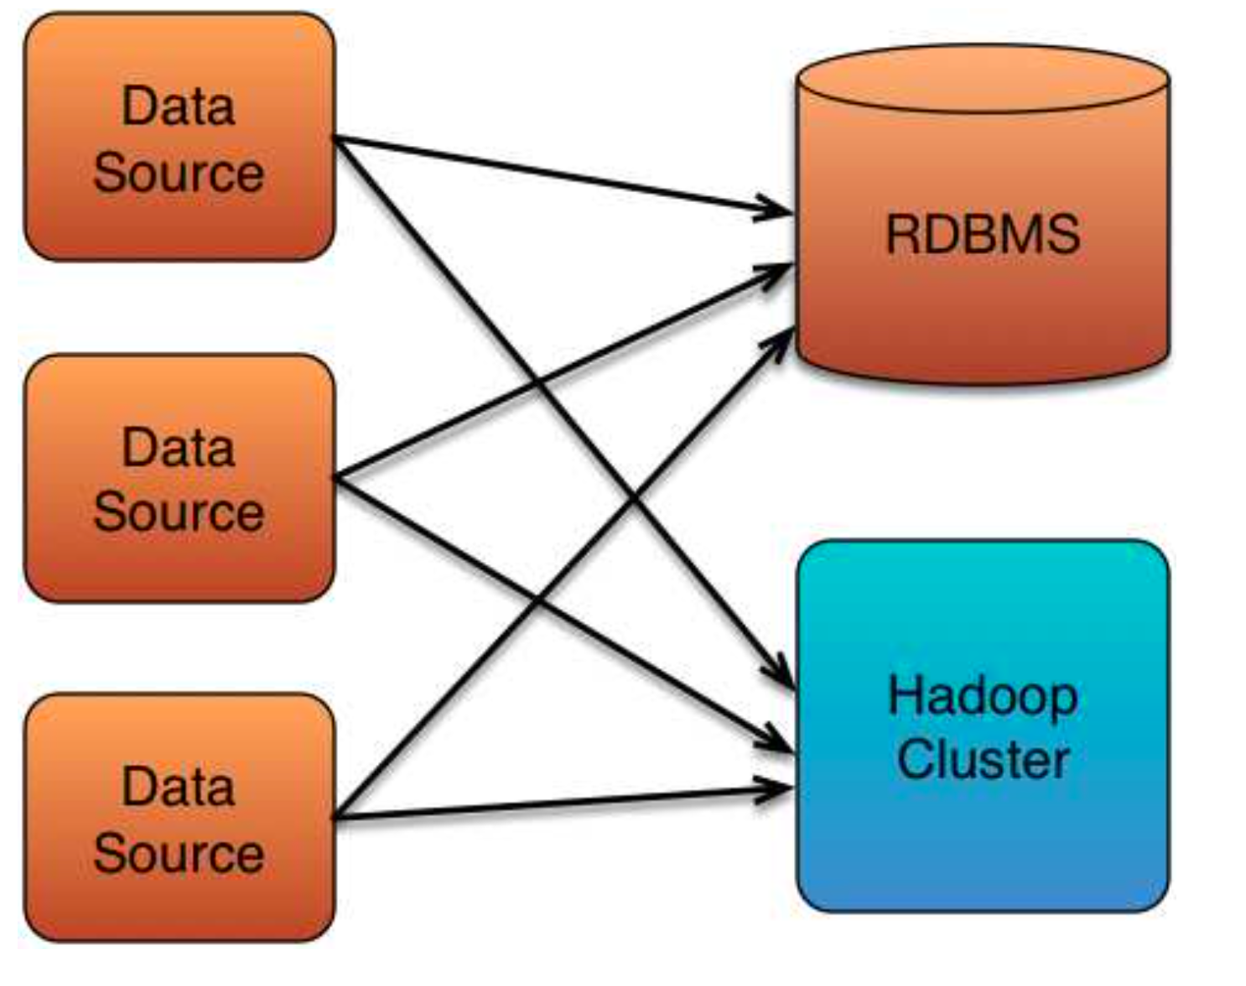
Ingestion is simple… right?
It is (relatively) easy to connect just a few systems together

Slide 9
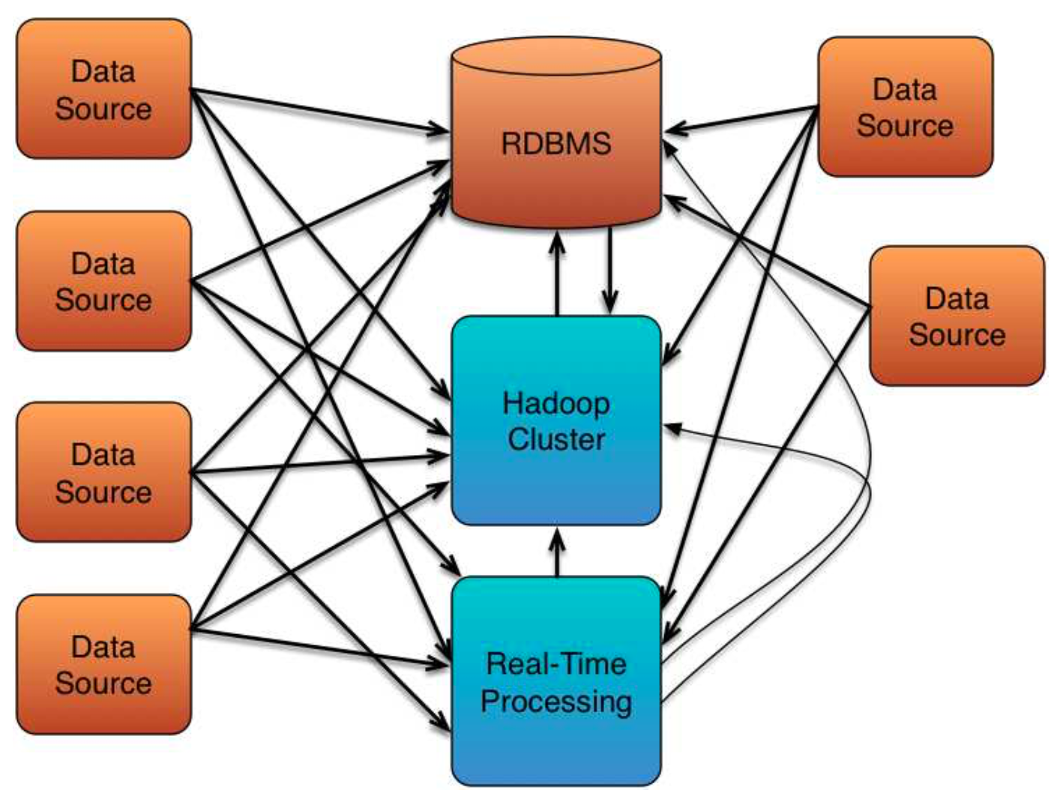
Ingestion is simple… right? (Not really)
As we add more systems, complexity increases dramatically

Slide 10
Ingestion is simple… right? (Nope)
...until eventually things become unmanageable

Slide 11
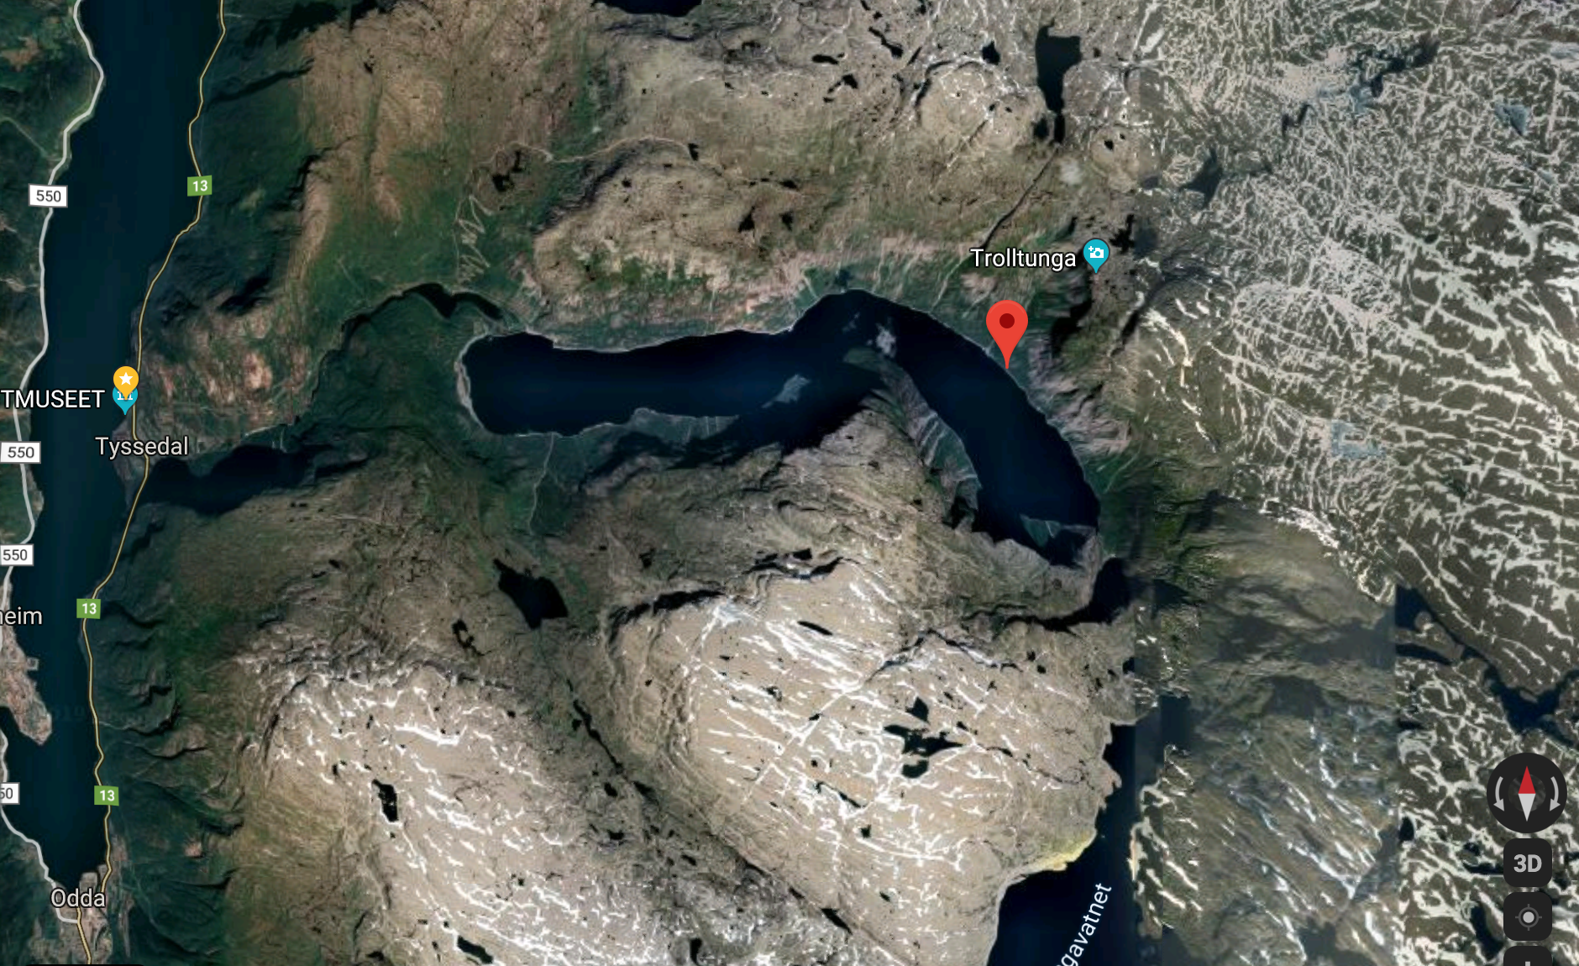
Start from BIG PICTURE

Slide 12
Start from BIG PICTURE
The Client motivation
Ask ”why”
Find out what are the driving requirements/objectives
97: Seek the value in requested capabilities
97: Diminish accidental complexity
https://learning.oreilly.com/library/view/97-things-every/9780596800611/

Slide 13
Short Story #0 – Spark is Gold Hammer
”There will be a large files, so we definitely need Spark” Customer

Slide 14
Short Story #0 – Spark is Gold Hammer
”There will be a large files, so we definitely need Spark” Customer
Small < 100 KB
1000 data feeds are small ( less 100 KB):
- Spark cluster start time will be more time than processing
- Bad cluster utilization
Large > 10 GB

Slide 15
Short Story #0 – Spark is Gold Hammer
”There will be a large files, so we definitely need Spark” Customer
Small < 100 KB
1000 data feeds are small ( less 100 KB):
- Use Spark for only for heavy jobs
- Use light-weight solution for others
Large > 10 GB

Slide 16
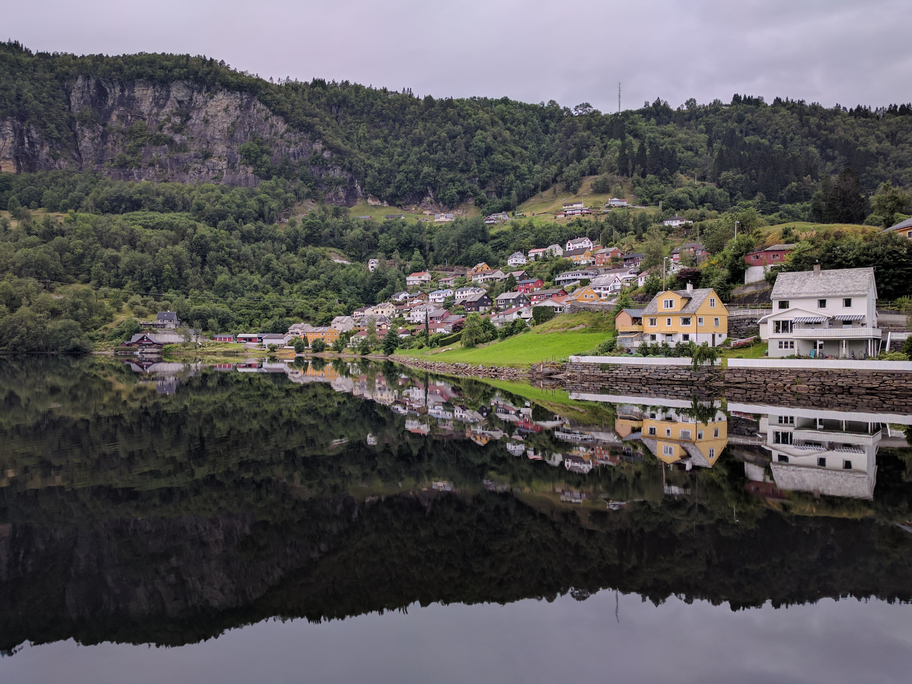
Let`s speak about sources

Slide 17
Let`s speak about sources: General
How many sources do you have now?
How this data will be used?
Have you worked with this data before?
What is planned scale/growth?
Is there are sensitive data?

Slide 18
Let`s speak about sources: Particulary about Data
Source types
Data formats
Schemaful/Schemaless
Metadata/Specification ( timestamps, watermarks, business dates etc)
Source statistics (avg, max, sd )
Size in bytes
Max number of columns

Slide 19
Let`s speak about sources: Particulary about Source system
Frequency
time-based
trigger-based (event-based, One-time-delivery, Only God knows)
How long dataset will be available?
Load on source system:
Number of parallel connectors
Direct connectors
Read window

Slide 20
Short Story #1 – Is it really time-based?
„We will provide file in last day of month at 1 a.m. CET” Customer

Slide 21
Short Story #1– Is it really time-based?
„We will provide file in last day of month at 1 a.m. CET,
if it will be weekend day, then in first working day.” Customer

Slide 22
Short Story #1 – Is it really time-based?
„We will provide file in last day of month at 1 a.m. CET,
if it will be weekend day, then in first working day.
If it will be bank holiday in Sweeden, then next working day.” Customer

Slide 23
Short Story #1 – Is it really time-based?
„We will provide file in last day of month at 1 a.m. CET,
if it will be weekend day, then in first working day.
If it will be bank holiday in Sweeden and files comes from Swedish MF system (you will need parse it first to get header with Sweeden code), then next working day.
If it will be bank holiday in Norway and files comes from Norway MF system (you will need parse it first to get header with Norway code), then next working day.” Customer

Slide 24
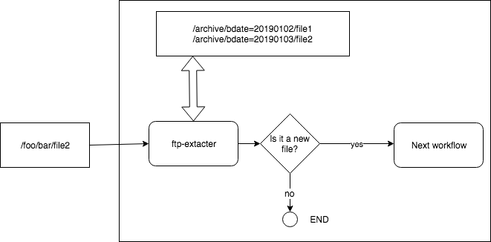
Short Story #1 – Is it really time-based?

Slide 25
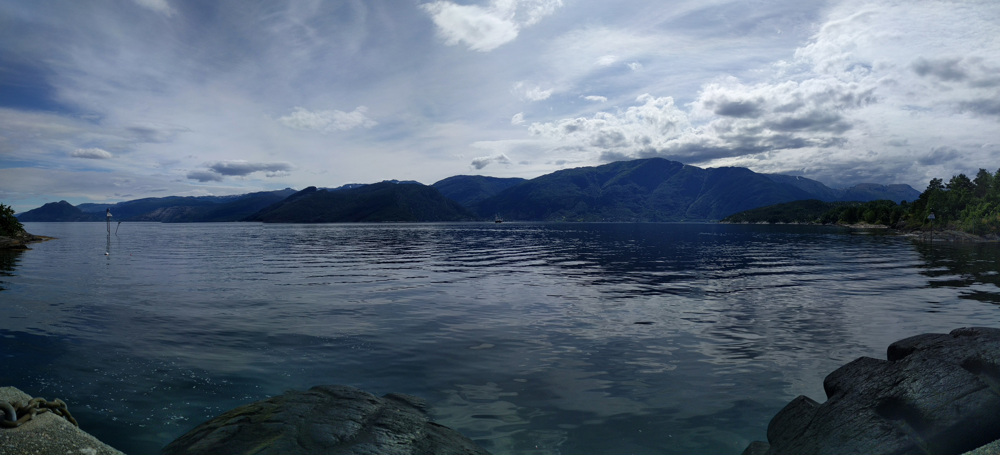
Let`s speak about sources: Data evolution
Is input data append-only?
Full ingest
Incremental
Mix of both
Schema evolution

Slide 26
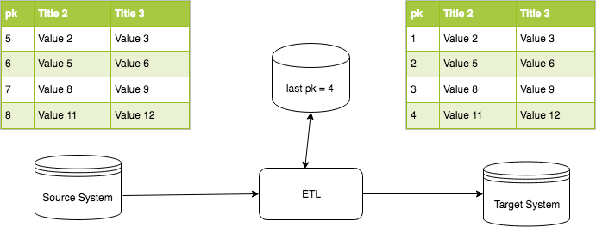
Short Story #2 – It is a simple JBDC source, you already suport it
Incremental Slowly Changing Dimensions (SCDs) 2-6 Types

Slide 27
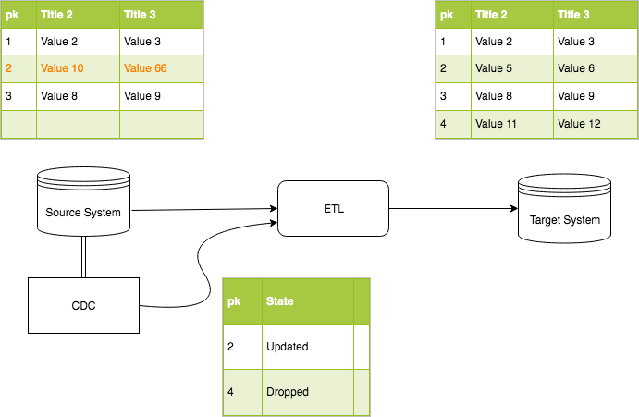
Short Story #2 - It is a simple JBDC source, you already suport it
Incremental
Snapshoting
with
Capture Data
Change
(CDC)

Slide 28
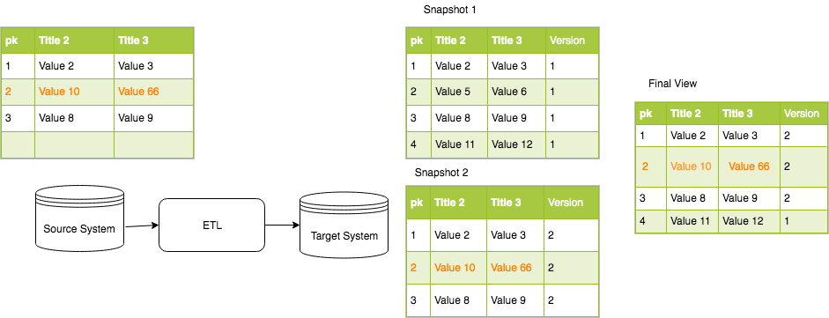
Short Story #2 - It is a simple JBDC source, you already suport it
Incremental
Snapshoting
with Merge

Slide 29
Transformations
Variety
Do you have dependencies ?
State
Fan-In/Fan-Out
Field Mapping

Slide 30
Short Story #3 – The Great Field Names
FILLER (duplicated 10 Times)
„THE SOME STRANGE FIELD”
Døðr / Колонна / 檐柱
02FIELD ( say ”HI” to AVRO)
…

Slide 31
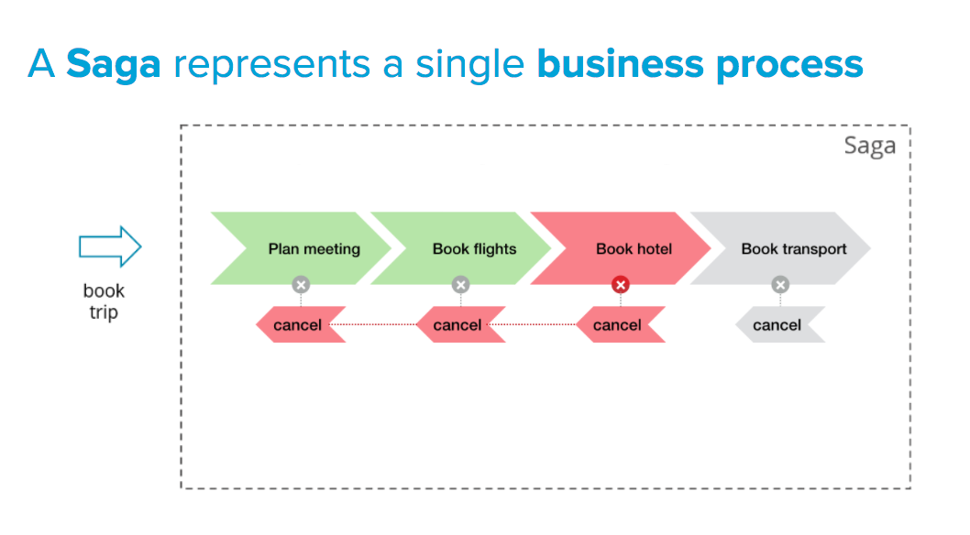
Additional flows
Exception flow
Investigation flow

Slide 32
What about our target?
Now you are source system ☺
End-User Delivery Interfaces
Idempotent write
SLA

Slide 33
Who else is your stakeholder?
Data Governance / Data Quaility
Data Lineage / Data Catalog
Complience/Regulations
Monitoring/ Log management

Slide 34
Any Questions?

Slide 35
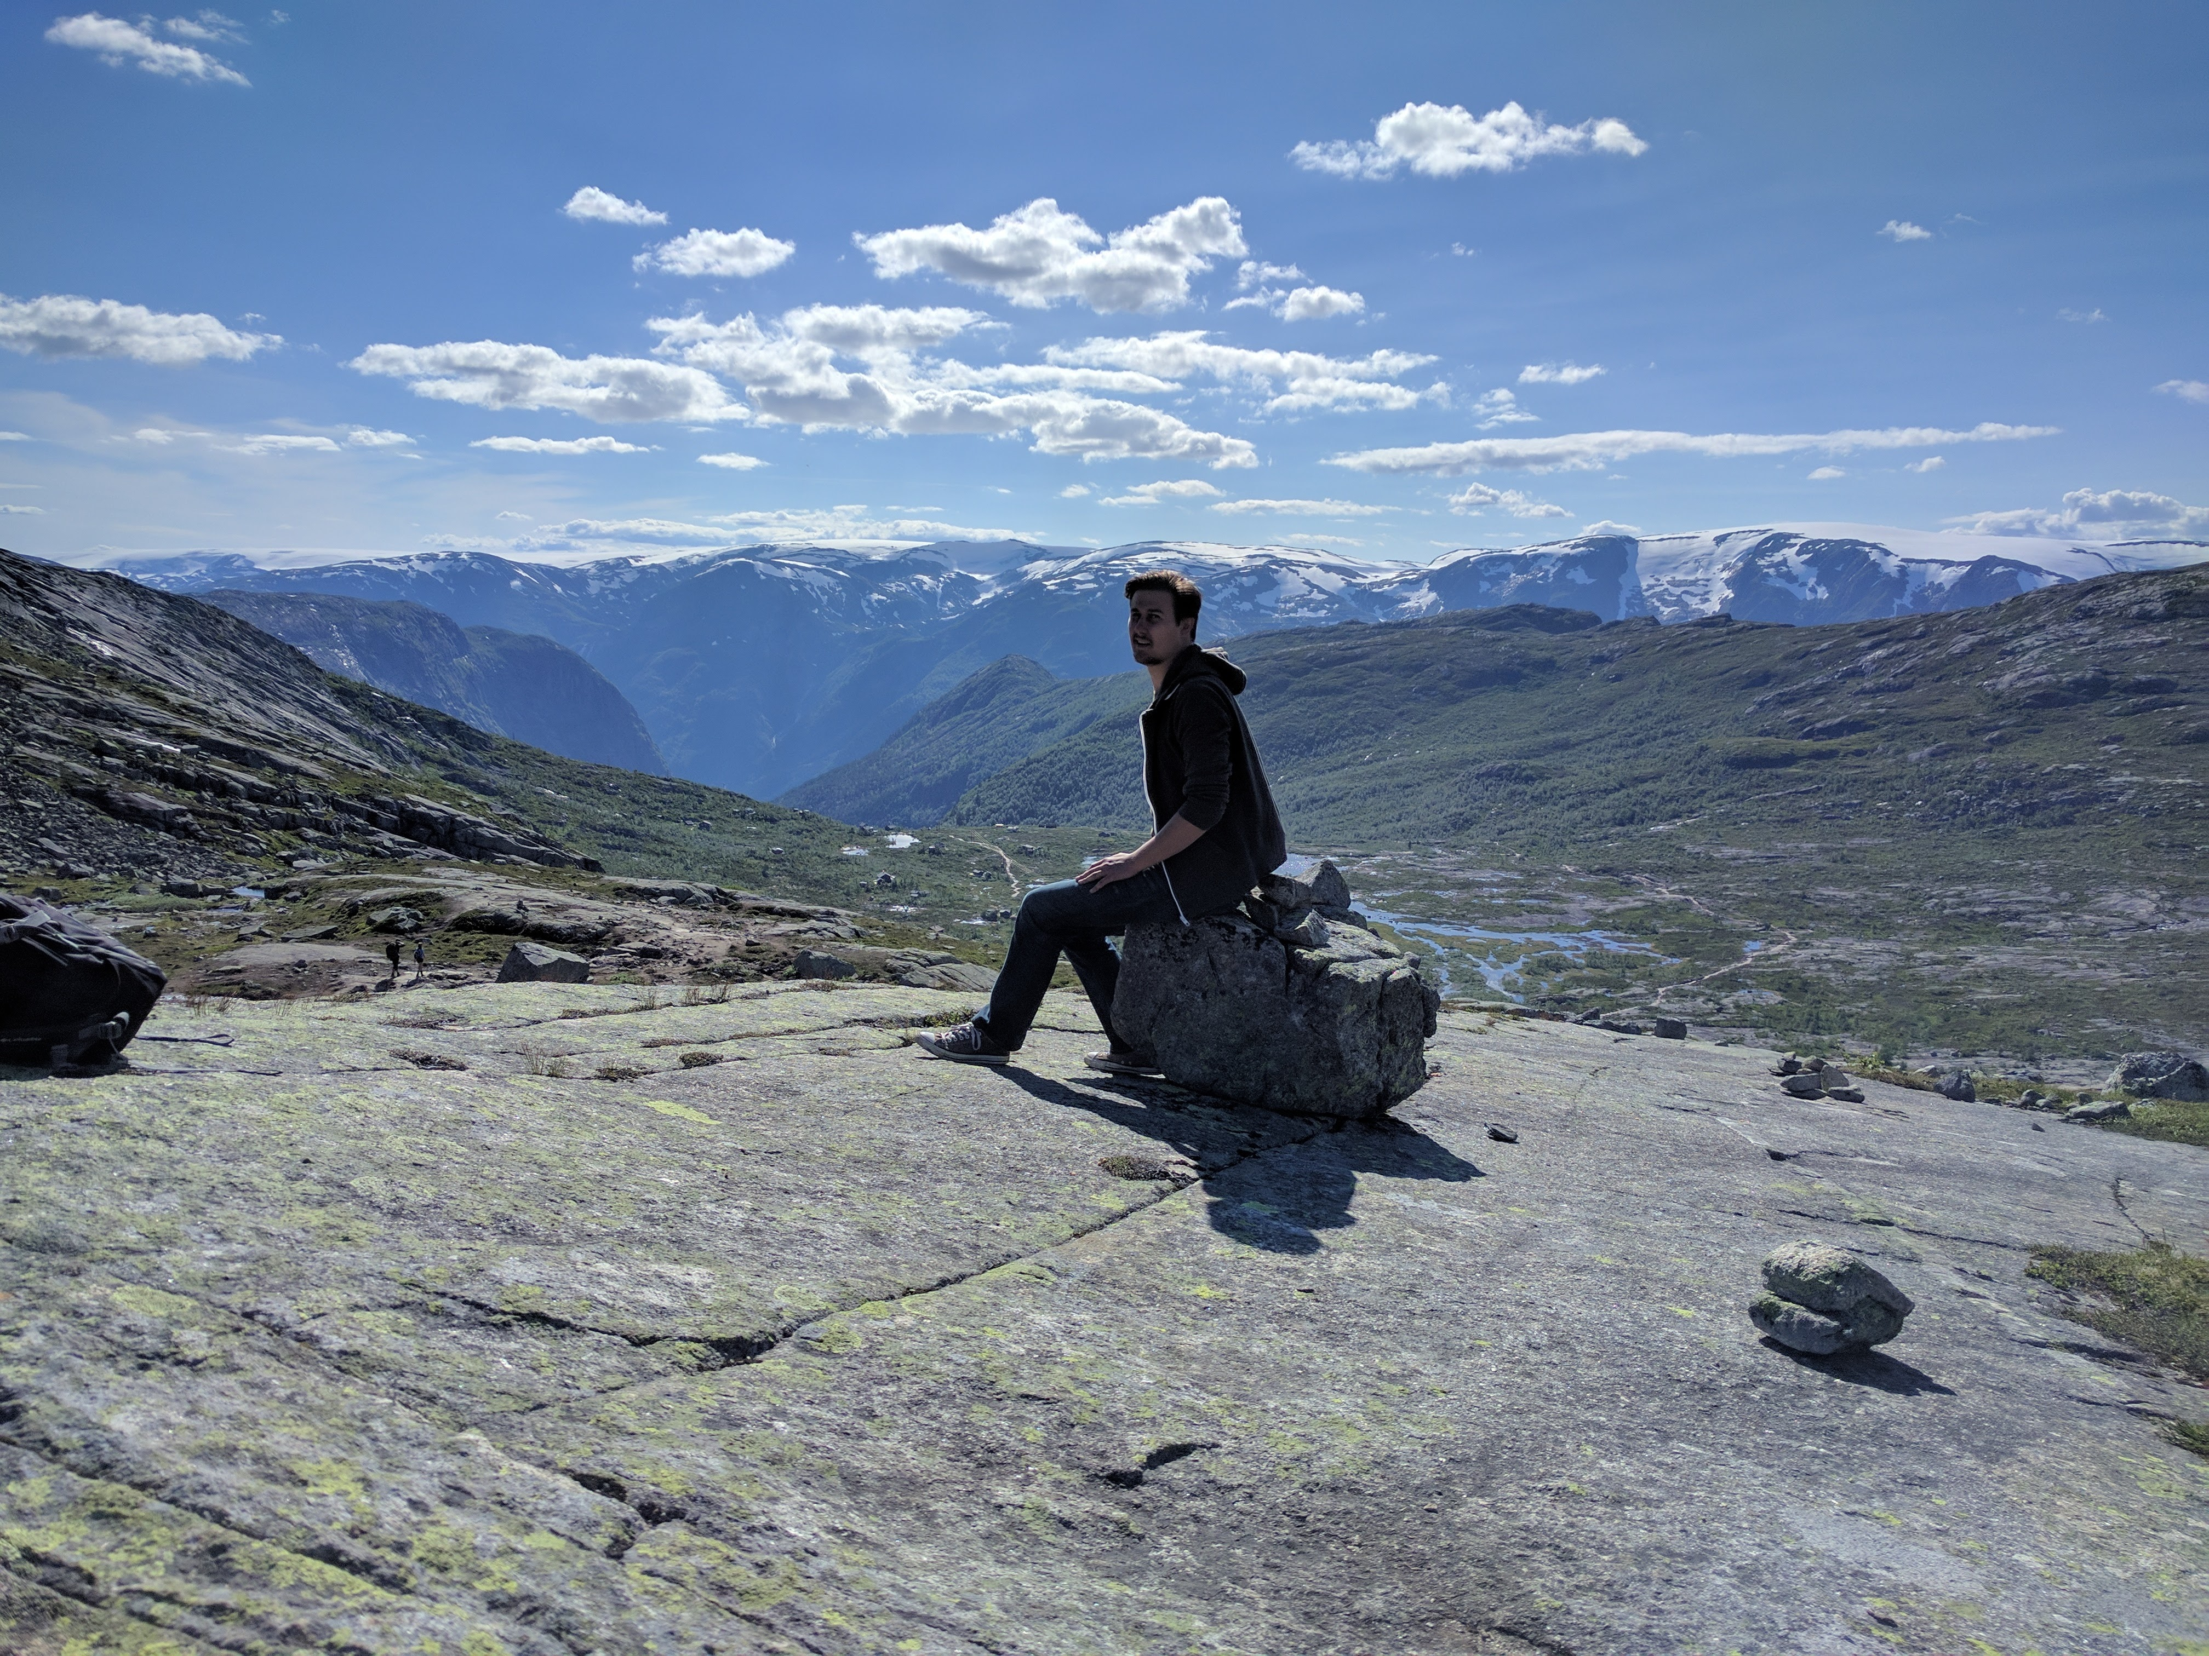
Thank you

